Slide 1
SCDF X IBM Lifesavers’ Innovation Challenge
Team Segfault
Matthew Liang, Sim Shang En, Kia Jia Han,
Cao Jialin Marianna and Allysa Tan
Notes:
Good Morning Judges, I am <name> from National Junior College representing Team Segfault. Today, I will be presenting our solution named HeartFault.

Slide 2
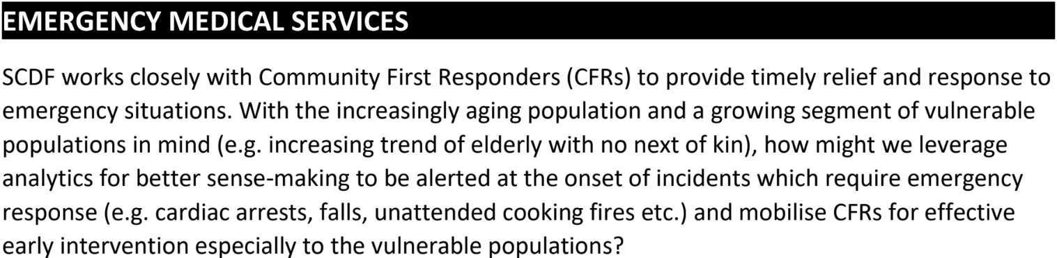

Problem Statement
The problem statement is asking for:
Improvements for emergency response
Using data analytics
Retrieved from: https://www.straitstimes.com/singapore/scdf-team-is-2nd-in-regional-crisis-response-contest
Notes:
The problem statement that we chose was the Emergency Medical Services statement which requires us to improve the emergency response system through early intervention using data analytics. Every day, around 17 people in Singapore die from heart diseases. Our team is addressing the issue of people who are at risk of heart attacks, such as those who have existing heart conditions or those who have high blood pressure.

Slide 3
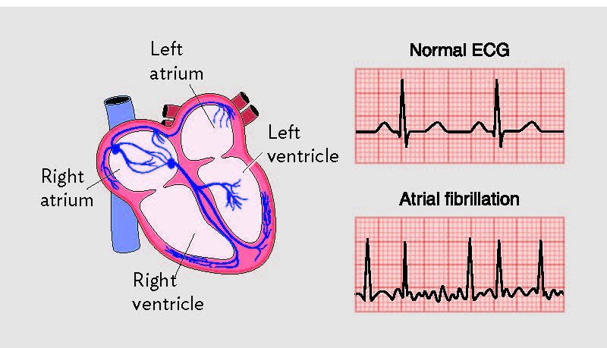
Heart Attacks
Silent myocardial infarction
Stroke
Heart Failure
Image Retrieved from https://www.unitypoint.org/cedarrapids/afib.aspx
Notes:
According to a survey conducted by insurance company Manulife, 7 in 10 Singaporeans cannot recognise symptoms of Atrial Fibrillation, which we will refer to as AF. Furthermore, AF may lead to many other diseases such as blood clots, stroke, heart failure and other heart-related complications.

Slide 4


Issues addressed
People having high risk of heart attack due to factors such as high cholesterol
People living alone or people without caretakers to look out for symptoms
Images Retrieved from https://www.dreamstime.com/stock-illustration-cartoon-lonely-man-sitting-ground-image73159251 and https://www.medicaldevice-network.com/news/pet-scan-heart-attack/
Notes:
When people do get a heart attack, they may be unable to get the immediate attention they require, especially for the vulnerable groups living alone. Occurrences of silent heart attacks are also not uncommon and leave scarring and damage to the heart if not detected early.

Slide 5
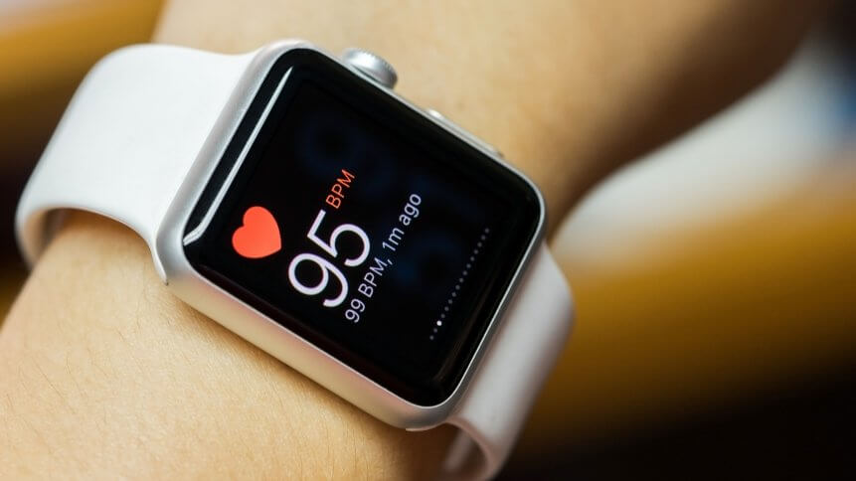
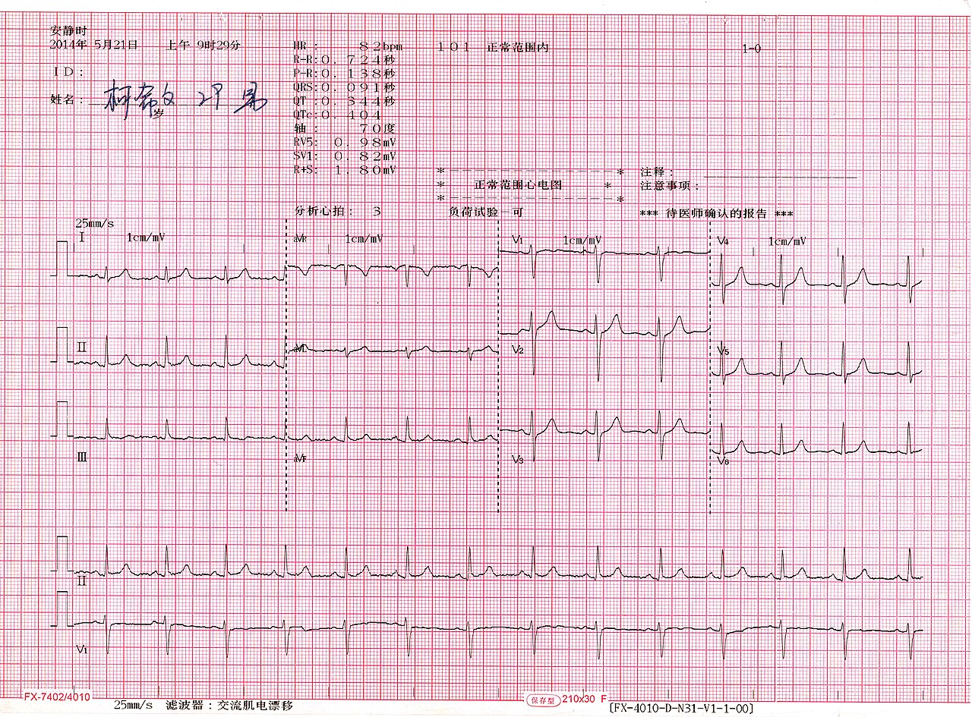
HeartFault
Electronic wearable that can be worn on a person’s wrist
ECG (electrocardiogram) signals can be detected
Image Retreived from https://techhq.com/2019/08/four-industries-taking-advantage-of-wearable-technology/ and Ptrump16 - Own work, CC BY-SA 4.0, https://commons.wikimedia.org/w/index.php?curid=77817932
Notes:
HeartFault is an electronic wearable device that can be worn on one’s wrist. This device will be able to measure a person’s heartbeat through an ECG sensor and detect signs of AF, which may lead to heart attacks or indicate that a silent heart attack could have already taken place. If there are such signs, there will be attempts to reach out to the wearer through the wearable vibrating and through phone calls. If the user does not respond, it is likely a heart attack has taken place and CRFs will be contacted and mobilised to the user’s location determined through GPS. This solution will allow for early intervention, especially for high-risk groups such as the elderly.

Slide 6
System Description
Alert first responders
Telegram Bot
GPS
Call 995
No response from User
IBM Machine Learning Service
Wearable
ECG signals
Alert User of AF
Notes:
This is our proposed system architecture design.

Slide 7
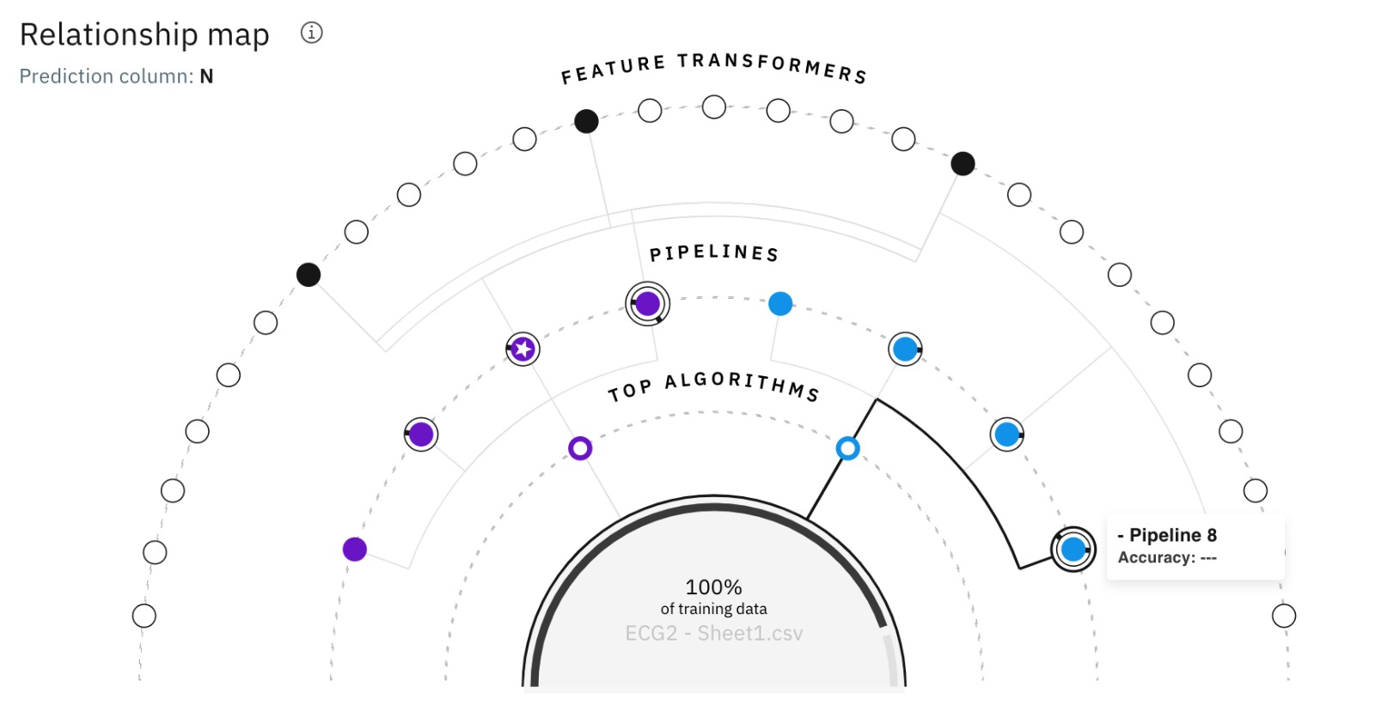
Auto AI System
Training data are uploaded onto Auto AI, which processes it
Features differentiate between normal and abnormal ECG heart signals
Auto AI trains the machine learning service to do the above
Abnormalities are detected and are used to deduce whether the user is at risk
Notes:
To train our machine learning system, we used a dataset from Physionet, which is a repository of freely-available medical research data maintained by MIT. The features in the data can be used to differentiate between normal and abnormal heart rate. The IBM AutoAI was used to train the machine learning service on datasets of ECG signals, which can then be used to determine if a person has AF or not.

Slide 8
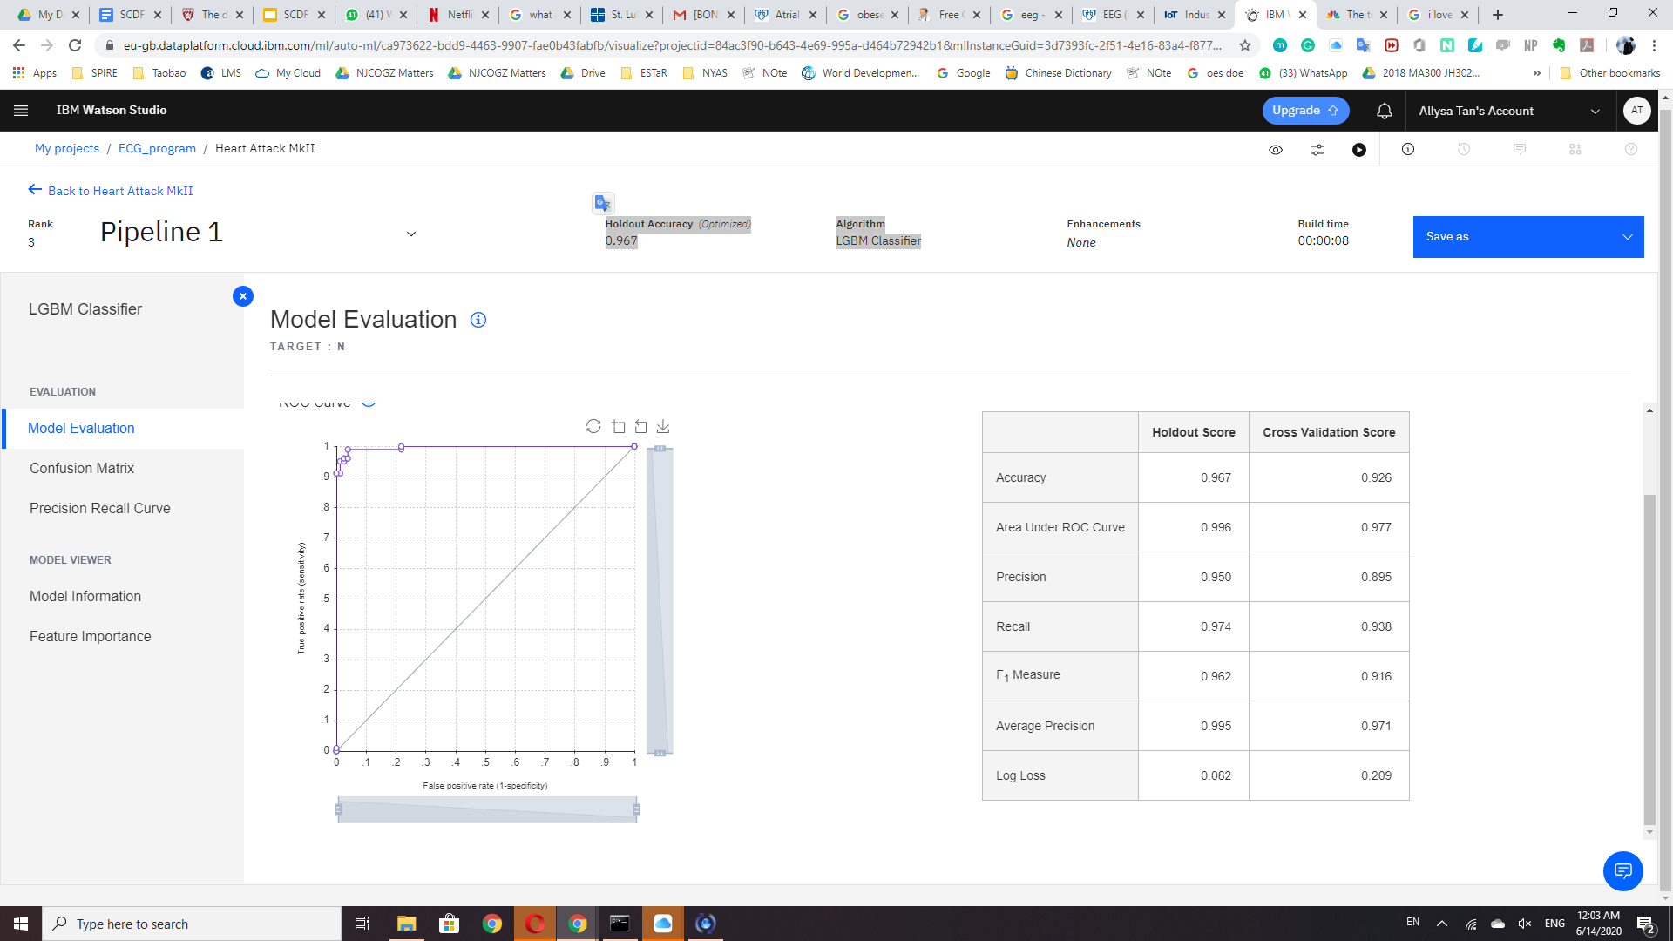
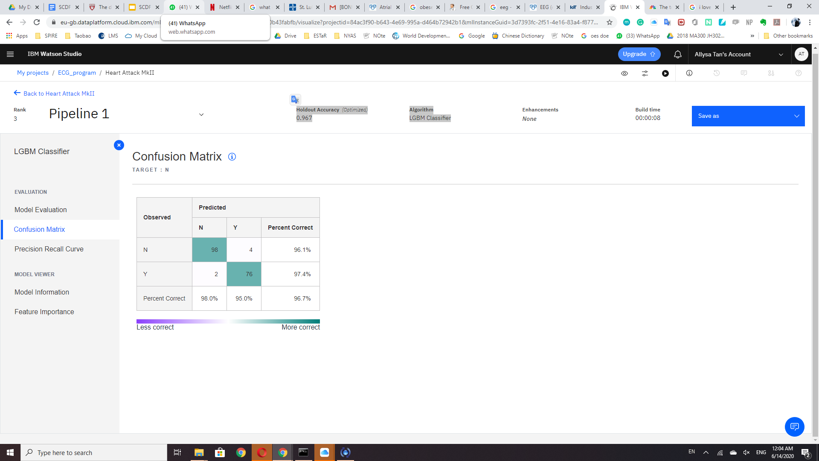
Model Accuracy
Using the LGBM Classifier, we have achieved an accuracy of 96.7%
Model Evaluation
Confusion Matrix
Notes:
The model achieves an impressive accuracy of 96.7%. False alarms are reduced and the confusion matrix shows excellent results.

Slide 9


Telegram bot
If there is no response from the person wearing the watch, watch sends alert to the first responders and provides the wearer’s location. Program will also call 995.
First responders will then check on the wearer
Retrieved from https://play.google.com/store/apps/details?id=sg.gov.scdf.RescuerApp&hl=en
Notes:
As a proof of concept, a Telegram Chatbot is used to notify the CRFs that are around that area that there is a person in need of emergency medical aid. The location of the wearer who may potentially be having a heart attack will be given to them so that they can go and check on them as soon as possible.
In the final solution, the SCDF myResponder App will be used to notify CFRs. CFRs can then proceed to the stated location and assist by performing CPR or applying an AED to revive the patient.

Slide 10
Plan of Action
Challenges:
Requires network connection to work
Mitigation Strategy:
Download the needed information such as the data files into the device
However, we are not able to do that with the current tools

Slide 11

Conclusion
We are able to mobilise CFRs for effective early interventions of AF and saving lives.
Image retrieved from https://h2hcardiaccenter.com/blog/2018/07/06/3-steps-to-a-healthy-heart/
Notes:
Our solution directly responds to the problem statement because it makes use of analytics to mobilise CFRs for effective early intervention for people who require emergency response in the form of heart attacks.

